Slide 1
Assembly Language and System Programming Lab9
2022/11/21

Slide 2
Targets
Different Inputs
String Remove

Slide 3
Target
Different Inputs
Add Different Inputs PROCEDURE in the code, and the input is v1, v2, v3
Target: check if the input is different
If the three value is different, then return “1” in eax, else “0”

Slide 4
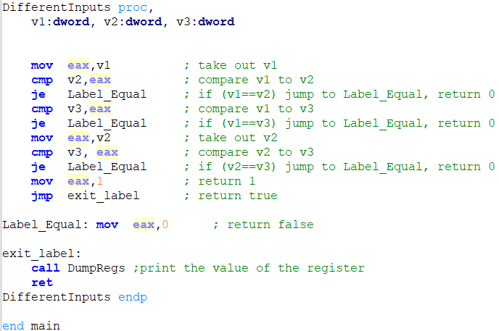
Method
Different Inputs
Compare V1 to V2 and V3
if (same): return 0 else: continue
if (V1!=V2 && V1!=V3): Compare V2 and V3
If (V2==V3):return 0 else: return 1 then skip “Label_Equal” and end the program

Slide 5
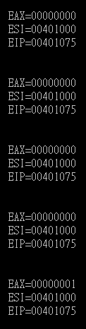
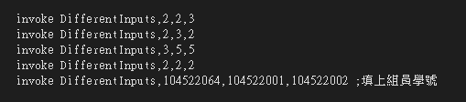
Result
Different Inputs

Slide 6
Goal
String Remove
Use Str_ PROCEDURE in the program. There are two inputs,
pStart : Points to the array.
nChars : The amount of characters that have to be deleted.
Main Goal : Delete n characters from the beginning.
For example: string = “12345” remove 3 characters, and your program should delete “123” and left “45” in the string.

Slide 7
Method
String Remove
Get String length by Str_length
Set new begining of the character, and the beginning of the delete position.
Copy the character from the new beginning to the start of delete position iteratively until it stops, then set the end character

Slide 8
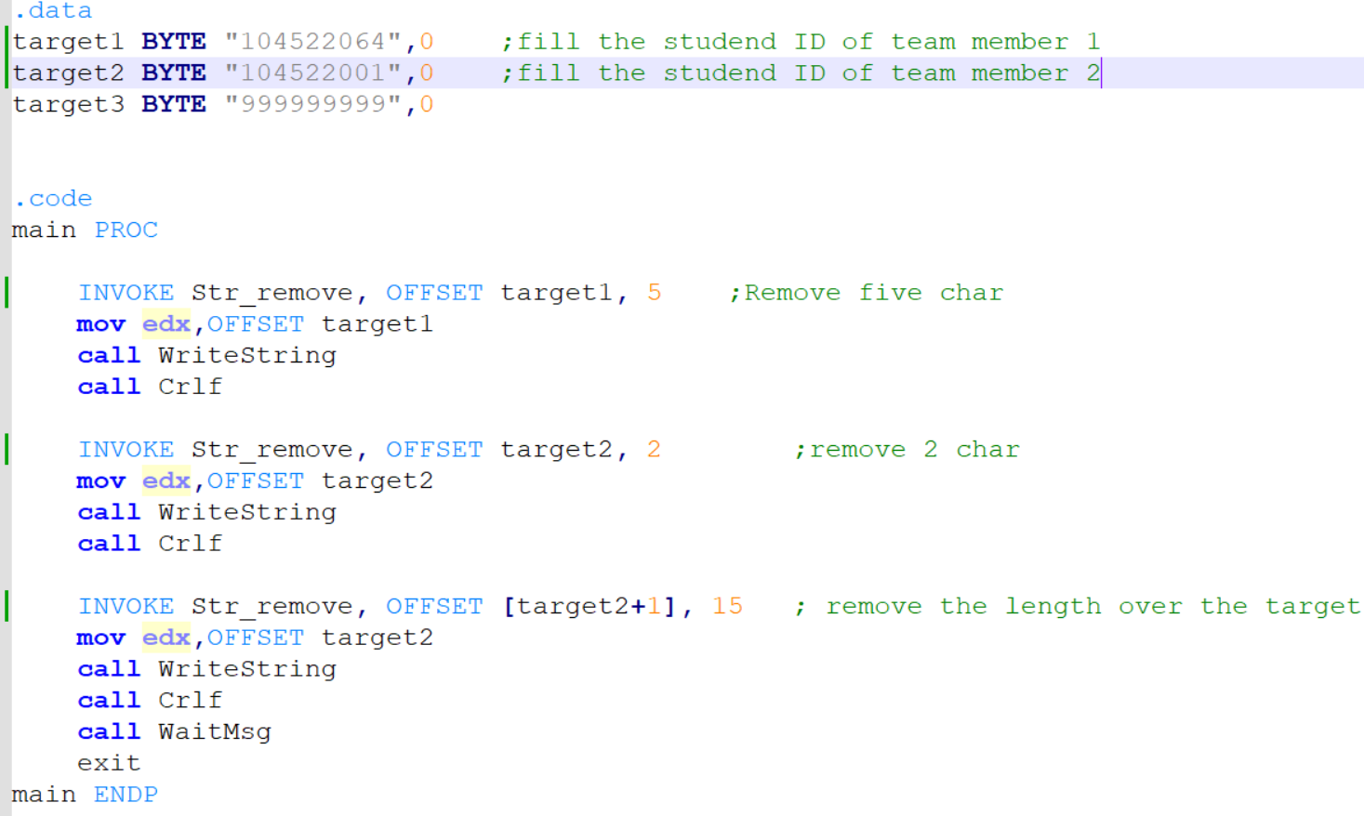
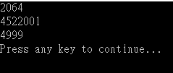
Result
String Remove
Tips: consider the stack order between the result of Target 2 and Target 3

Slide 9
Report
Deadline : 2022/11/22(Tue.) Before 12:00 P.M. (EEClass)
Each group only needs to submit one report
Pack the following files and compress into .zip file.
Zip file name -> (ex: lab9_groupX.zip)
Code (lab9_groupX.asm)
Report (lab9_groupX.doc or lab9_ groupX.pdf)
Title
Group、StudentID、Name
Screenshots of Result and Code + Explanation
The report has to clearly explain how the program works.
Thoughts about the lab.
Please must be aware of the file name.
If you want to update your file, please give a new file name (ex: lab9_group01_v2.zip).

Slide 10
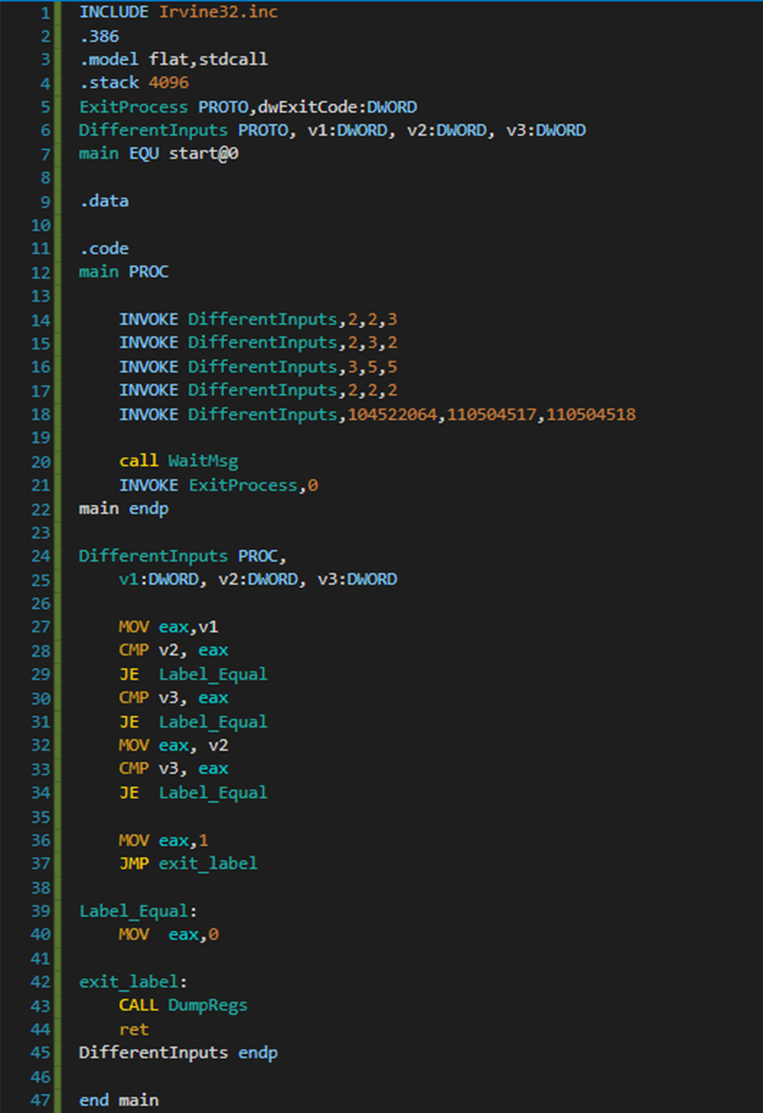
if (v1 == v2)
return 0
else if (v1 == v3)
return 0
else if (v2 == v3)
return 0
else
return 1

Slide 11
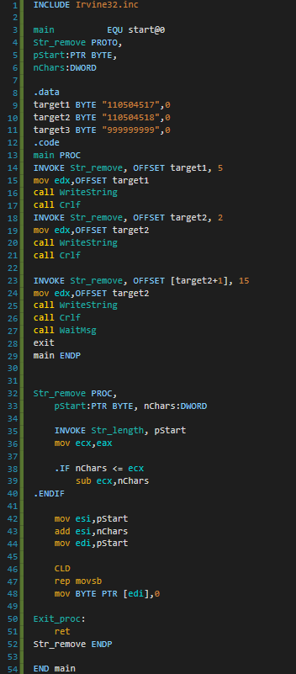
PROC execute
Get string length,
string end with 0 (null byte)
Calculate loop times
esi = ptr + removeCount
(as new ptr after removed chars)
edi = ptr
execute char replace (copy)
add null byte as string end

